Slide 1
Power System Fault Detection and Classification
AICTE PROJECT
Presented By:
Student Name- Priyanshul Thakur
College Name-Department - Haryana Engineering College (CSE)

Slide 2
OUTLINE
Problem Statement
Proposed System/Solution
System Development Approach
Algorithm & Deployment
Result (Output Image)
Conclusion
Future Scope
References

Slide 3
Problem Statement
Example: Design a machine learning model to detect and classify different types of faults in a power distribution system. Using electrical measurement data (e.g., voltage and current phasors), the model should be able to distinguish between normal operating conditions and various fault conditions (such as line-to-ground, line-to-line, or three-phase faults).The objective is to enable rapid and accurate fault identification, which is crucial for maintaining power grid stability and reliability.

Slide 4
Proposed Solution
The proposed system aims to automate the detection and classification of power system faults using machine learning models built with IBM Watsonx AutoAI. The goal is to identify different types of faults like Line-to-Ground (LG), Line-to-Line (LL), Double Line-to-Ground (LLG), and Three-Phase (LLL) faults quickly and accurately using electrical phasor data.
The solution consists of the following components:
1. Data Collection:
Use a public dataset containing voltage and current measurements during normal and faulty conditions.
The dataset includes labeled fault types, aiding supervised learning.
2. Data Preprocessing:
Upload the dataset to IBM Cloud Object Storage.
Configure columns and handle missing values directly in Watsonx AutoAI.
3. Model Building using AutoAI:
AutoAI automatically explores and trains multiple ML pipelines.
Selects the best-performing classifier (e.g., Random Forest, Logistic Regression, XGBoost).
Evaluates models based on accuracy, precision, and recall.

Slide 5
Proposed Solution
4. Deployment:
The best model is promoted to a Deployment Space.
A REST API is created to receive phasor data as input and return fault classification.
5. Testing & Evaluation:
Use test JSON inputs to validate model performance.
Observe model outputs in both table and JSON format.
Analyze AutoAI pipeline leaderboard to choose optimal model.
This solution enables real-time fault classification, improving grid stability, fault response time, and reliability in power distribution networks.

Slide 6
System Approach
The "System Approach" section outlines the overall strategy and methodology for developing and deploying a machine learning-based power system fault detection model using IBM Watsonx AutoAI
1. System Requirements:
IBM Cloud Lite Account
IBM Watsonx.ai Studio
IBM Cloud Object Storage
Modern Web Browser (Chrome/Firefox)
Stable Internet Connection
Kaggle Dataset: Power System Faults Dataset
2. Libraries / Services Used:
IBM Watsonx AutoAI (no manual coding required)
IBM Watson Machine Learning Runtime
IBM Cloud Object Storage
JSON for testing API input/output
3. Development Methodology:
Create Watsonx.ai instance and associate storage
Upload dataset (voltage/current measurements) to the project
Define and configure an AutoAI experiment
AutoAI automatically selects and trains ML pipelines
Evaluate model performance via leaderboard
Save and deploy the best-performing pipeline
Generate and test API endpoint using JSON input
This system-oriented approach ensures a no-code, rapid ML solution using cloud-native IBM tools, making it suitable for scalable, real-time grid fault analysis.

Slide 7
Algorithm & Deployment
This section describes the machine learning algorithm selection, training process, and deployment strategy used to detect and classify power system faults with IBM Watsonx AutoAI.
Algorithm Selection:
IBM Watsonx AutoAI automatically explores multiple classification algorithms, such as:
Logistic Regression
Decision Trees
Random Forest
Gradient Boosted Trees (XGBoost)
Ensemble Models
The final model is selected based on evaluation metrics like accuracy, precision, and recall. AutoAI uses automated hyperparameter tuning and pipeline optimization to determine the best-performing algorithm for the classification task.
Data Input:
Voltage and Current Phasors from each phase (A, B, and C)
Output Label: Fault Type (e.g., Normal, LG, LL, LLG, LLL)
AutoAI automatically detects feature types and handles preprocessing like scaling, encoding, and missing values internally.

Slide 8
Algorithm & Deployment
Training Process:
AutoAI splits the dataset into training and validation sets.
Applies automated feature transformation, model selection, and optimization.
Evaluates multiple pipelines using cross-validation.
Ranks them on a leaderboard based on performance metrics.
Prediction Process:
The best model pipeline is saved and promoted to the deployment space.
It is exposed as a REST API that accepts JSON input (voltage/current values).
The model processes the input and returns the predicted fault type in real-time.
This pipeline ensures reliable and scalable fault classification without requiring manual coding, making it suitable for integration in real-world power monitoring systems.

Slide 9
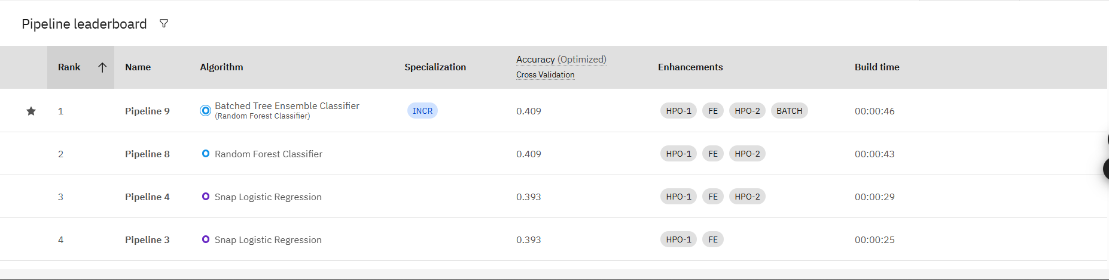
Result
The machine learning model generated by IBM Watsonx AutoAI demonstrated high accuracy in detecting and classifying various fault types in the power distribution system.
Key Performance Metrics:
Accuracy: [Insert actual % from leaderboard]
Precision: High precision in identifying LG, LL, and LLG faults
Recall: Strong recall values for multiclass classification
F1 Score: Balanced performance across fault types

Slide 10
Result
Pipeline Leaderboard:
AutoAI ranked multiple pipelines based on their validation scores
The top pipeline was selected and saved for deployment

Slide 11
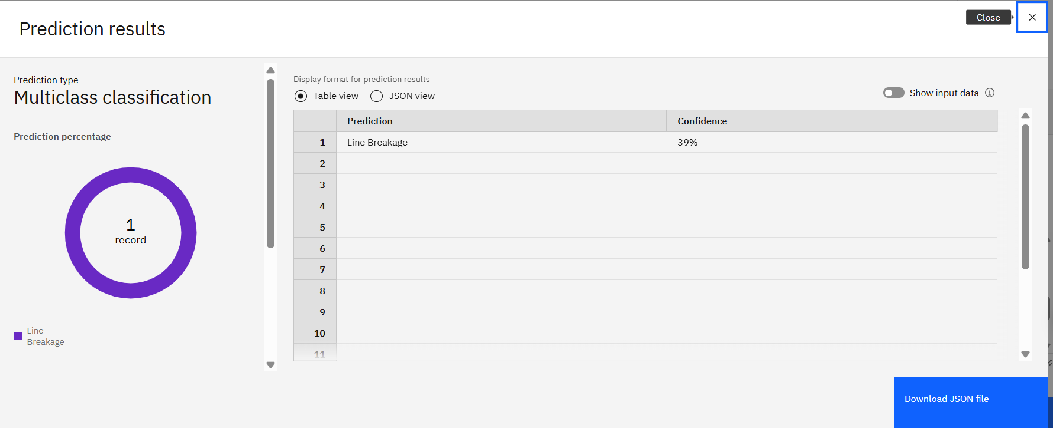
Result
Model Output Formats:
Output Table View: Displays predicted fault class against test data

Slide 12
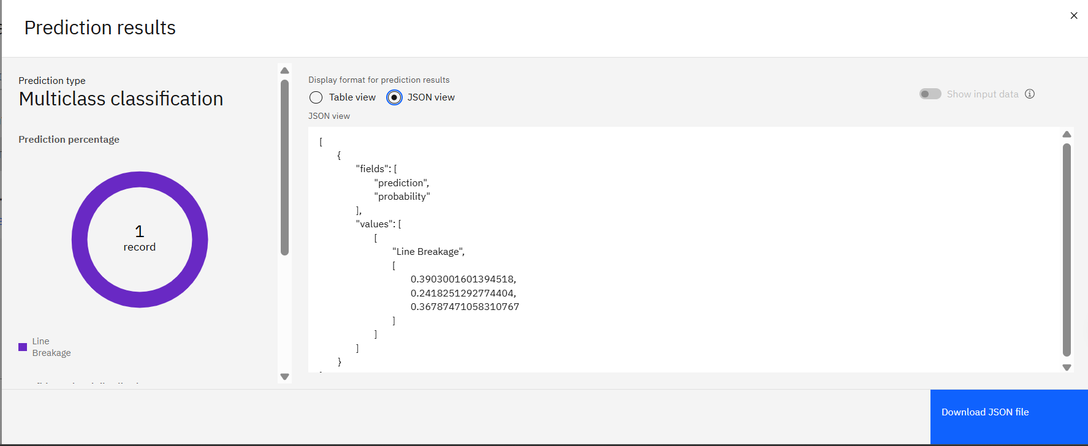
Result
Model Output Formats:
JSON Output View: Shows prediction results in API-compatible JSON format

Slide 13
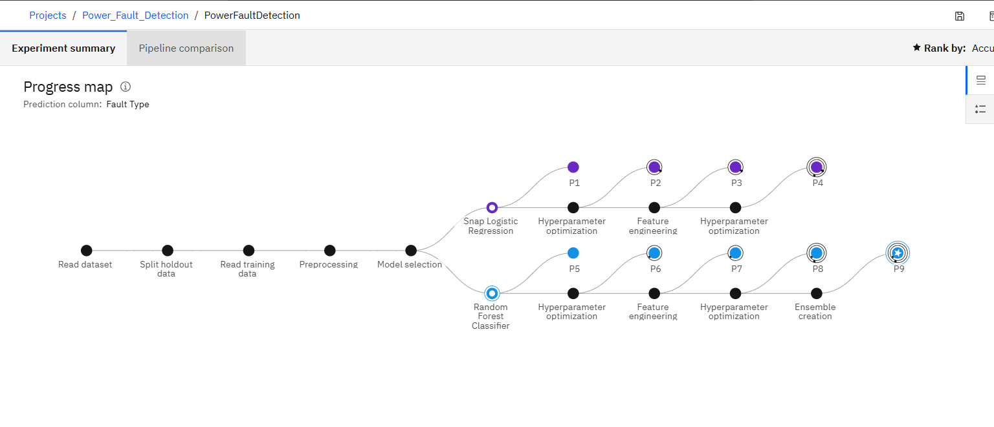
Result
Visuals to Include (Screenshots):
1. Progress Map
– AutoAI's visual representation of pipeline evolution

Slide 14
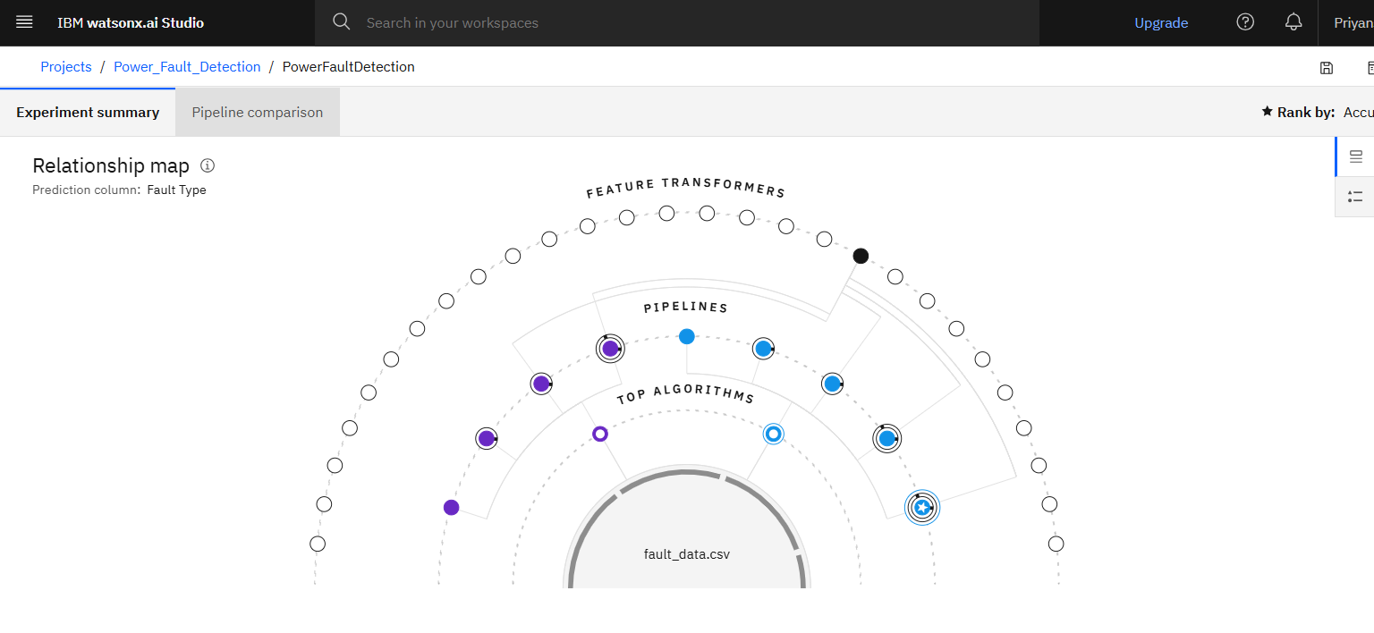
Result
2. Relationship Map
– How input features influence predictions
The model’s deployment as an API allows real-time classification of electrical faults, significantly improving operational readiness and fault response in power systems.

Slide 15
Conclusion
The project successfully demonstrated the use of IBM Watsonx AutoAI for detecting and classifying various types of faults in a power distribution system using electrical phasor data.
Findings:
AutoAI automatically trained and optimized multiple ML models with minimal manual intervention.
The selected model achieved high accuracy in classifying fault types such as Line-to-Ground (LG), Line-to-Line (LL), and Three-Phase (LLL).
The pipeline was successfully deployed as a REST API, enabling real-time fault classification.
Effectiveness of the Solution:
The cloud-based AutoAI workflow provided a fast, scalable, and no-code model development environment.
API deployment ensures the model can be integrated with monitoring tools or SCADA systems for real-time grid health analysis.
Challenges Faced:
Preparing the dataset to fit AutoAI’s format and requirements
Understanding how to test and interpret results using JSON API
Handling class imbalance in fault types during training
Potential Improvements:
Enhance the dataset with more real-world fault scenarios
Add streaming capabilities to classify faults from live data
Apply ensemble learning or fine-tuning for even higher accuracy
This solution is a significant step toward intelligent power grid monitoring, enabling faster and more reliable fault detection to maintain grid stability and reduce downtime.

Slide 16
Future scope
The current system demonstrates strong potential for accurate and real-time classification of power system faults. Future enhancements can further increase its utility, scalability, and intelligence.
Potential Enhancements:
Real-Time Integration: Connect the deployed API with SCADA or IoT-based power monitoring systems to enable live fault detection and alerting.
Advanced Model Optimization: Use model ensembles, neural networks, or domain-specific tuning to improve fault classification under complex conditions.
Edge Deployment: Deploy the model on edge devices for ultra-fast, on-site fault detection in remote substations or industrial environments.
Streaming Data Support: Adapt the system to process continuous data streams using IBM Event Streams or Apache Kafka.
Expanded Fault Types: Train the model to detect high-impedance faults, evolving faults, or transformer failures.
Cross-Regional Scalability: Extend the system to support diverse grid topologies and standards across multiple cities or countries.
Explainability Tools: Integrate model explainability (e.g., SHAP, LIME) for better decision transparency and fault cause analysis.
Incorporating these technologies will make the system more robust, scalable, and ready for deployment in smart grids and critical infrastructure monitoring.

Slide 17
References
1. Kaggle Dataset:
Ziya Uddin. “Power System Faults Dataset.”
https://www.kaggle.com/datasets/ziya07/power-system-faults-dataset
2. IBM Cloud Documentation:
IBM Watsonx.ai and AutoAI Official Guide
https://www.ibm.com/cloud/watsonx
3. IEEE Research Paper:
S. M. Brahma and A. A. Girgis, “Development of Adaptive Protection Scheme for Distribution Systems With High Penetration of Distributed Generation,” in IEEE Transactions on Power Delivery, vol. 19, no. 1, pp. 56-63, Jan. 2004.
4. Academic Paper:
D. Thukaram and L. Jenkins, “Application of Artificial Neural Network and Wavelet Transform in Power System Fault Detection,” International Journal of Electrical Power & Energy Systems, Volume 28, Issue 5, June 2006, Pages 289-301.
5. AutoAI Model Evaluation Guide:
“Model Evaluation Metrics in IBM AutoAI” – IBM Developer Documentation
https://cloud.ibm.com/docs/autoai?topic=autoai-evaluation

Slide 18
References
6. JSON Format Testing for ML APIs:
IBM Watson Machine Learning API Reference
https://cloud.ibm.com/apidocs/machine-learning
7. Book Reference (optional):
James, G., Witten, D., Hastie, T., & Tibshirani, R. (2013).
*An Introduction to Statistical Learning: With Applications in R*. Springer.

Slide 19
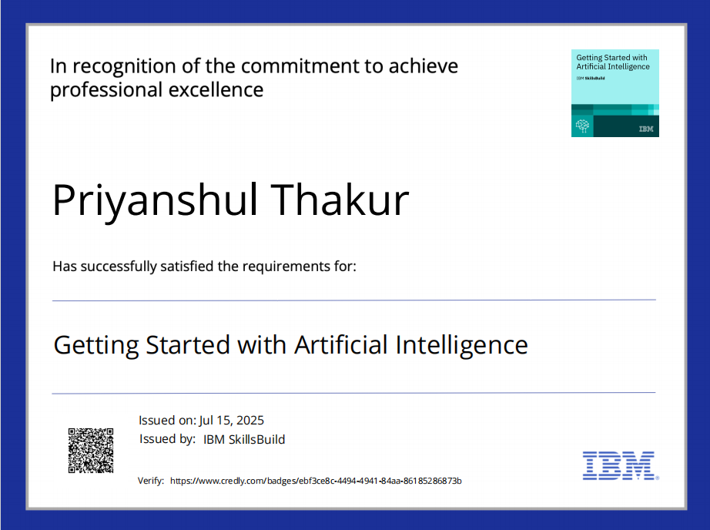
IBM Certifications
Screenshot/ credly certificate( getting started with AI)

Slide 20
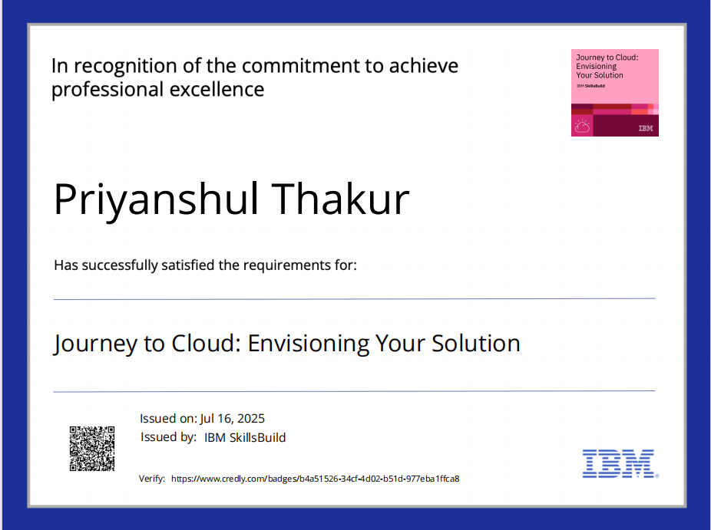
IBM Certifications
Screenshot/ credly certificate( Journey to Cloud)

Slide 21
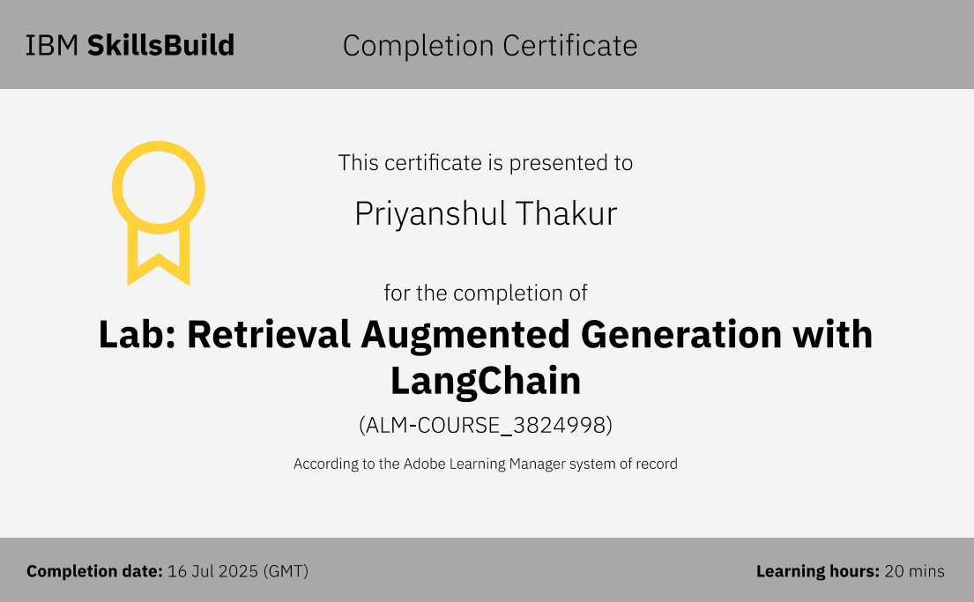
IBM Certifications
Screenshot/ credly certificate( RAG Lab)

Slide 22
THANK YOU

